Slide 1
Capstone project proposal presentation: EM parameterization of CF
Students: Ha Tran, Thanh Le, Jeffrey Brown
Advisor: Branjmir Pejcinovic
Sponsor: Tangitek LLC

Slide 2
Requirements from project description
From 300 MHz to 30 GHz
Dielectric constant, complex electric permittivity, magnetic permeability, loss tangent and layer thickness
Simulation model for validation
NRL arch

Slide 3
Project management
Trello, GitHub, Giant Chart
Project main phase
Project Initialization: Research for approaches of material characterization
Prototype: NRL arch and waveguide with current part availability. Absorption coeffect of control sample (PVC) is calculated and compared with previous result
Optimization: cover all frequency ranges, arch for antenna, antenna chamber.
Presentation: PSU capstone presentation

Slide 4
Technical approach: NRL Arch and waveguide
NRL Arch
Advantage: Industrial standards, different incident/reflection angles
Disadvantage: Big sample size (greater than 5 lambda), antenna alignment
Waveguide
Advantage: Higher dynamic range, small sample
Disadvantage: sample preparation (require perfect contact between sample and waveguides)

Slide 5
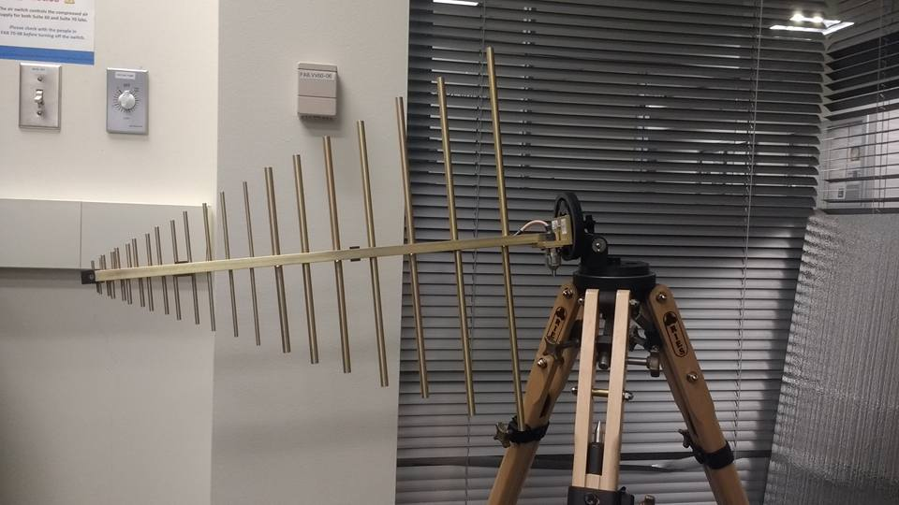
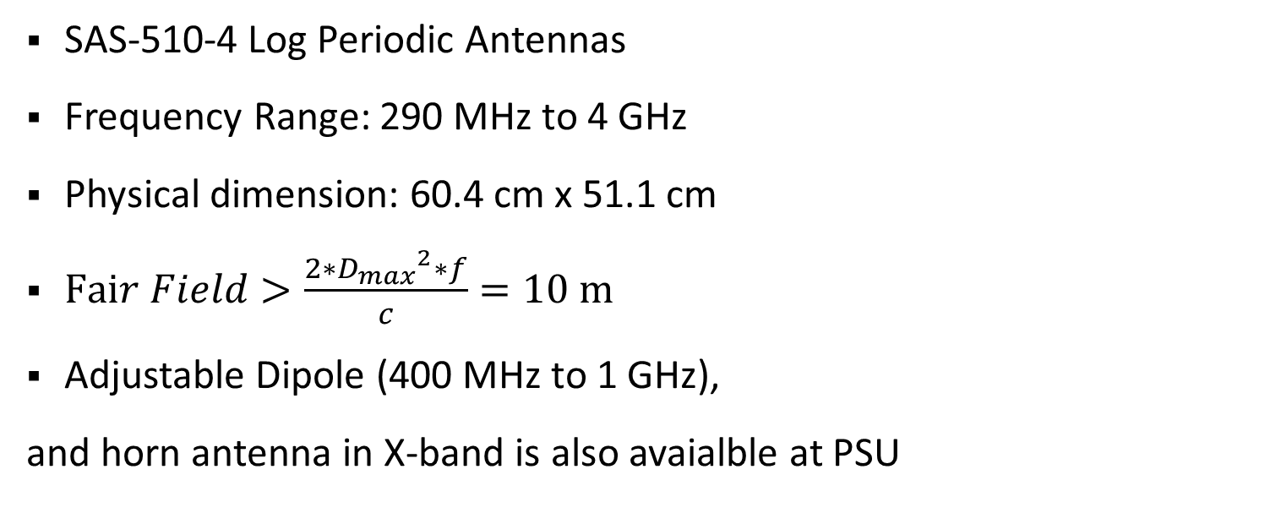
NRL arch prototype: Antennas
SAS-510-4 Log Periodic Antennas
Frequency Range: 290 MHz to 4 GHz
Physical dimension: 60.4 cm x 51.1 cm
$Fair Field>\frac{2∗{D_{max}}^{2}∗f}{c}=10 m$
Adjustable Dipole (400 MHz to 1 GHz),
and horn antenna in X-band is also avaialble at PSU
-for more info…List location or contact for specification (or other related documents)

Slide 6
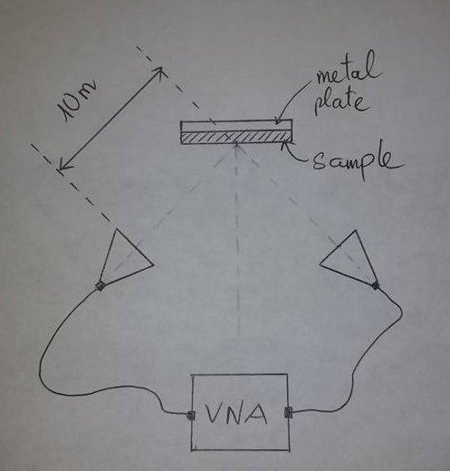
NRL arch prototype: Measurement setup
VNA is used as both the stimulus and detector of microwave signals
Signal from the reflective plate (without the sample) provides a reference signal for calibration
Reflectivity in dB = 10*log10 (P1/P0)
Absorption coefficient of PVC is calculated and compared.

Slide 7
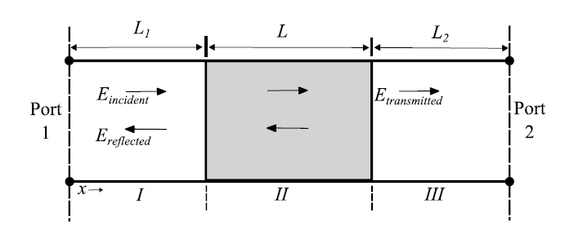
Waveguide prototype: measurement setup
L: a segment of rectangular waveguide where a sample has been placed
L1, L2: hollow rectangular waveguide
Port 1 and Port 2 are connected to VNA
using adapters.
Equations for complex epsilon and mu are provided in Microwave Electronics: Measurement and Materials Characterization
L.F. Chen et al 2004,
Microwave Electronics: Measurement and
Materials Characterization

Slide 8
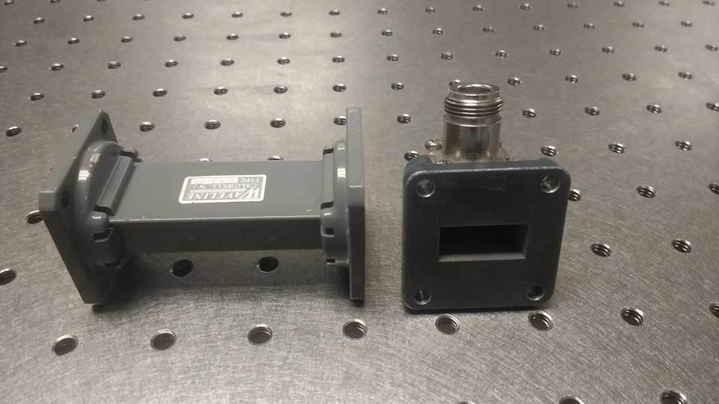
Waveguide prototype: parts
PSU has waveguide and adapter in X-band (figure)
We still need to find a sample holder (a segment of X-band waveguide that has suitable size for the sample) and a TRL calibration kits
Reflect standards: A X-band waveguide short termination
Line standards: A X-band waveguide segment (90 degree long line at center frequency)

Slide 9
Procedures: optimization
Interactive Solver: Solving both material thickness and material properties at the same time. Provide higher accuracy
Arch for antenna:
Partially filled waveguide:
EM simulation: EM Pro, avaialble for students at PSU
Modeling:
-for more info…List location or contact for specification (or other related documents)

Slide 10
Current Status
Finish gathering parts avaialble at PSU. We need detailed information about sample size and antenna/waveguide printing capability
Equations and measurement setup for prototype of NRL arch and waveguide are avaialble.

Slide 11
Related Documents and References
GitHub: https://github.com/trankhiemha/ECE412-413-Capstone-Project-N3
Trello page: https://trello.com/b/Ov0bqGiB/initial-cf-planning
All related documents are available in GitHub
Project progression tracking is available in Trello

